Slide 1
What’s New in Java 6 & 7

Slide 2
Presentation Topics
In this presentation, we will cover:
Language Features
API Additions

Slide 3
Objectives
When we are done, you should be:
Familiar with current state of Java
Aware of new features

Slide 4
Language Features

Slide 5
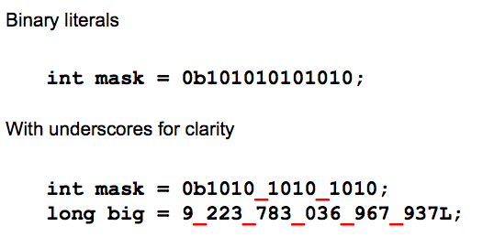
Literal Improvements

Slide 6
Simplification of Strings
Strings are constants - And - treated like primitives (at least from a coding perspective)
But until Java 7 – weren’t supported in switch statements
String a = “Hello”;
. . .
switch(a) {
case “hello”:
case “Hello”:
case “HELLO”
//do something
break;
default:
//do something else
break;
}

Slide 7
Simplification of Generics
Current way of declaring and initializing a type-safe collection List<String> list = new ArrayList<String>();
Compiler should be “smart enough” to infer type from declaration
New syntax List<String> list = new ArrayList<>();

Slide 8
Simplification of try/catch
There’s a lot of try/catch/finally boiler-plate code out there
Why not let the compiler generate it for you?
FileInputStream fis; try { fis = new FileInputStream(“/tmp/myfile.txt”); … } catch(IOException ioe) { …
} finally { fis.close() }
New way
try (InputStream fis =new FileInputStream(“/tmp/myfile.txt”)) { … }

Slide 9
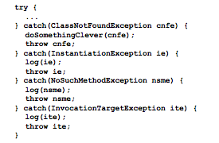
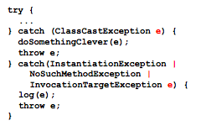
Simplification of try/catch
Do we really need all those catches?

Slide 10
API Improvements
Java 5, 6, and 7

Slide 11
New APIS
Java 5 – 747 new classes or APIs
Java 6 – 567 new classes or APIs
Java 7 – 292 new classes or APIs

Slide 12
Strings
java.lang.String
Better support for CharSequence
Built-in support for format
isEmpty()
java.lang.StringBuilder
More efficient implementation of StringBuffer
Mutable String

Slide 13
Threads
New methods in Thread
getStackTrace
getAllStackTraces
getId
getState
set/getDefaultExceptionHandler
set/getUncaughtExceptionHandler

Slide 14
java.util.Arrays
New methods in Arrays to provide same functionality Arrays have in other languages
deepHashCode()
deepEquals
toString
deepToString

Slide 15
java.util.Collections
New methods in Collections:
checkCollection/Set/List…
emptySet/List/Map
reverseOrder
frequency
disjoint
newSetFromMap
asLifoQueue

Slide 16
Collections Framework
New set of collection interfaces
Deque / BlockingDeque – double ended queue
Head operations: add / get / remove / peek
Tail operations: add / get / remove / peek
BlockingDeque – deque with blocking
NavigableSet / NavigableMap / ConcurrentNavigableMap
Sorted Collection with better navigation methods
Lower, floor, ceiling, higher
headSet/headMap, tailSet/tailMap, subSet/subMap

Slide 17
Collections Framework
New concrete implementations
ArrayDeque
ConcurrentSkipListSet
ConcurrentSkipListMap
LinkedBlockingDeque
A Skip List
Data structure for storing a sorted list
Uses a hierarchy of linked lists
Lookup is log n

Slide 18
java.net
New classes in 1.6
java.net.CookieManager
java.net.CookiePolicy
java.net.CookieStore
java.net.HttpCookie
java.net.IDN
java.net.InMemoryCookieStore
java.net.InterfaceAddress
java.net.NetworkInterface

Slide 19
java.nio.file
New Package in 1.7
Contains ~36 classes like
java.nio.file.Path
java.nio.file.Filesystem
java.nio.file.attribute
java.nio.file.Files
Java.nio.file.WatchService

Slide 20
java.util.concurrent
13 New classes for 1.7
java.util.concurrent.ConcurrentLinkedDeque
java.util.concurrent.ForkJoinPool
java.util.concurrent.ForkJoinTask
java.util.concurrent.ForkJoinWorkerThread
java.util.concurrent.LinkedTransferQueue
java.util.concurrent.locks/AbstractQueuedLongSynchronizer
java.util.concurrent.locks/AbstractQueuedSynchronizer
java.util.concurrent.Phaser
java.util.concurrent.RecursiveAction
java.util.concurrent.RecursiveTask
java.util.concurrent.ScheduledThreadPoolExecutor
java.util.concurrent.ThreadLocalRandom
java.util.concurrent.TransferQueue

Slide 21
Core Platform – Scripting
JSR 223 – Scripting for the Java Platform
Java Applications can host scripting engines
Defined as a service
Scripting engines can be discovered through “service discovery” mechanism
Scripting engine should be contained as a JAR
Includes Mozilla Rhino as its JavaScript engine
Currently implementations include
AWK
BeanShell
FreeMarker
Groovy
JavaScript
Jython
Jruby
and more…

Slide 22
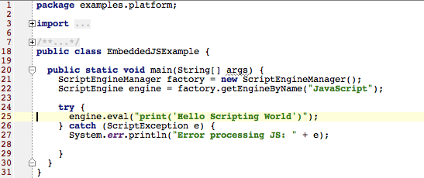
Scripting Example – Embedded JS

Slide 23
Core Platform – Scripting
Scripting support is full featured
Embedded – like example
External file – load in file and have engine evaluate it
Variables, functions, and methods
Java constructs including classes and interfaces
For more information see:
http://java.sun.com/developer/technicalArticles/J2SE/Desktop/scripting/
http://java.sun.com/javase/6/docs/technotes/guides/scripting/programmer_guide/index.html
http://jcp.org/en/jsr/detail?id=223

